Slide 1
"Breast Cancer Recurrence Prediction Project”

Slide 2
Introduction
Cancer starting in breast cells, prevalent in women.
The cause is unknown, but risk factors include age, gender, family history, genetic mutations (BRCA1, BRCA2), hormones, and lifestyle.
Early detection is critical for successful treatment.
Mammograms commonly used for early identification.

Slide 3
Problem Statement
Predicting the likelihood of recurrence or death is crucial for effective patient management.
Develop a classification model leveraging patient information and tumor characteristics.

Slide 4
Methodology in Focus
Data collection.
Wrangling and Cleaning.
Exploratory data analysis (EDA).
Feature Engineering
Data Splitting, Normalization, and Hyperparameter Tuning

Slide 5
Data Collection and Cleaning
686 records, 12 variables.
No missing values, ensuring dataset completeness.
Descriptive stats computed for variable distributions.

Slide 6
Exploratory Data Analysis (EDA)
Insights:
Column Handling:
Dropped 'Unnamed: 0' for clarity and efficiency.
Age Distribution:
Diverse range, with majority aged 45-65.
Menopausal Status:
~370 patients in postmenopausal stage.
Positive correlation between age and menopausal status.

Slide 7
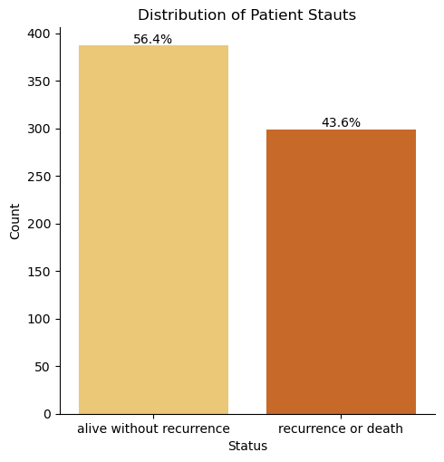
Exploratory Data Analysis (EDA)
Categorical Analysis:
56.4% alive without recurrence, 43.6% faced recurrence or death.

Slide 8
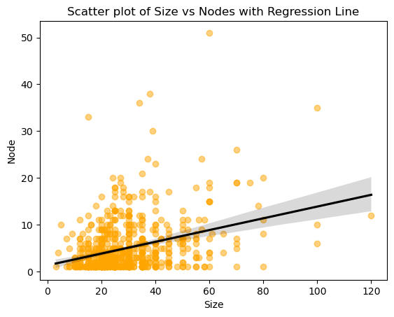
Exploratory Data Analysis (EDA)
Findings:
Impact of tumor size on node count.

Slide 9
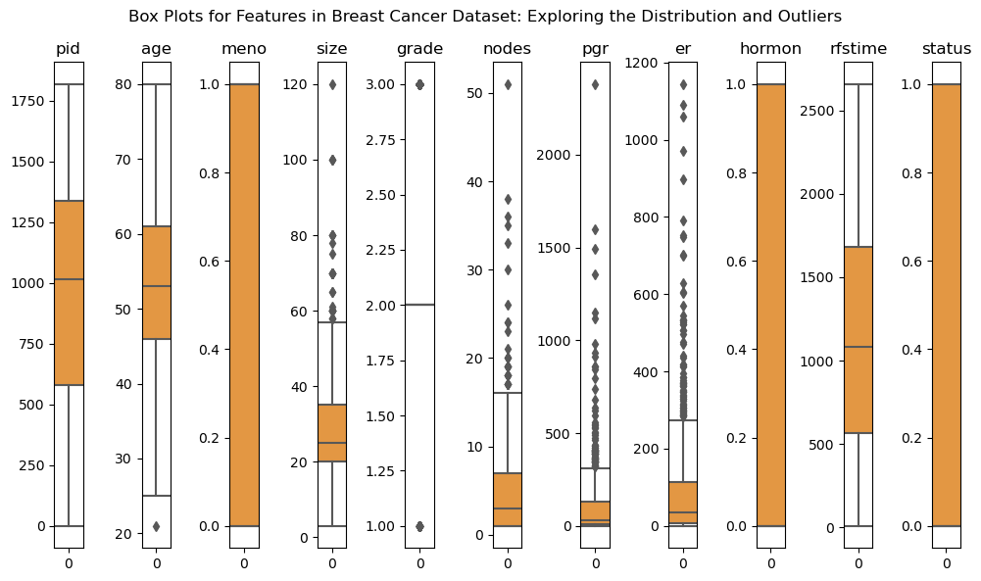
Exploratory Data Analysis (EDA)
Findings:
Presence of outliers requires further investigation.

Slide 10
Feature Engineering
Outlier Analysis and Handling
Decision Process:
Balanced decision on outlier inclusion/exclusion.
Objective:
Preserve valuable info while ensuring robust modeling.
Method Used:
Interquartile Range (IQR) for outlier removal.
Implementation:
Calculated bounds, identified outliers (0.5-95)
Default Multiplier:
1.5 deemed reasonable.

Slide 11
Data Splitting, Normalization, and Hyperparameter Tuning
Dataset Preprocessing:
Phases:
Splitting into training and testing sets (Test size = 0.2)
Normalization (StandardScaler)
Hyperparameter tuning.
Considered Models:
Types:
Logistic Regression, K-NN, Decision Tree, Random Forest, AdaBoost, XGBoost.

Slide 12
Model Evaluation and Classification Reports
Classification Reports:
* Metrics Focus:
Accuracy, Precision, recall, F1-score.
* Emphasis:
Specifically on predicting breast cancer recurrence or death (class 1).

Slide 13
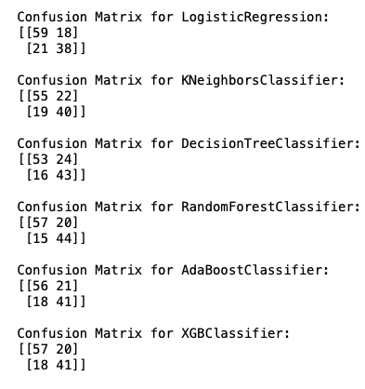
Model Evaluation and Confusion Matrix

Slide 14
Clinical Implications and Recommendations
False Negatives Significance:
Overlooking urgent cases impacts patient outcomes.
Prioritize minimizing false negatives for enhanced sensitivity.
Sensitivity Priority:
Sensitivity (recall) crucial for capturing recurrence or death cases.
Future model iterations focus on maximizing sensitivity.

Slide 15
Final Model: Random Forest Classifier
Model Features:
Features Included: tumor grade, hormonal therapy, patient age, tumor size.
Parameters and Hyperparameters:
Random Forest instantiated with following key hyperparameters
Hyperparameters: 'n_estimators’: 50, 'min_samples_leaf’:2.
Performance Metrics:
Model evaluation focused on breast cancer recurrence or death (class 1).
Key metrics:
Accuracy: Overall correctness of predictions (74%).
Precision: Proportion of true positive predictions among positives (70%).
Recall (Sensitivity): Proportion of true positives among actual positives (75%).
F1-score: Harmonic mean of precision and recall (72%).
Confusion Matrix: Random Forest shows promising results with high true positives: 44 (identifying cases of recurrence or death) and low false negatives: 15 (misclassifications).
demonstrating balanced precision and recall.

Slide 16
Ideas for Further Research
Longitudinal Data Analysis:
Explore integration for understanding dynamic breast cancer progression.
Incorporating Genomic Data:
Consider gene expression profiles and mutations.
External Validation and Real-world Application:
Consider application in real-world clinical settings.

Slide 17
Concrete Recommendations for Implementation
Clinical Decision Support Integration:
Collaborate with healthcare institutions for model integration.
Empower healthcare professionals with a tool for identifying high-risk cases.
Patient Education and Empowerment:
Develop educational materials based on model insights.
Empower patients with knowledge about risk factors and proactive measures.
Contribute to early detection and encourage active patient participation in their care.
Continuous Model Refinement:
Establish a framework for ongoing model refinement.
Incorporate feedback from clinicians and updated medical standards.
Regular reassessment and improvement ensure model relevance and reliability in evolving healthcare landscapes.

Slide 18
Thank you

